Slide 1
Gas Formulas
“How Much Gas Do We Use?”

Slide 2
Gas Formulas - Overview
Philosophies and Standards
2. Formula and Calculations
3. Practical Applications

Slide 3

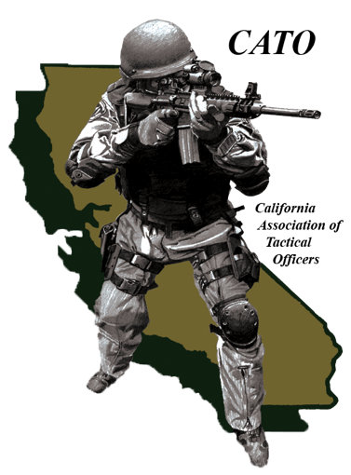
Gas Formulas - Philosophies
National Tactical Officer’s Association (NTOA)
California Association of Tactical Officers (CATO)

Slide 4
NTOA - Philosophy
Based on use of force “reasonableness” standard
(Graham vs. Connor).
Don’t need a formula to use other forms of force.
LCT₅₀ based on faulted research:
  No consideration given to biological/metabolic differences.
  Conducted in static sealed containers.
  CS was intended for outside riot control, not inside sealed environments.

Slide 5
CATO - Philosophy
LCT50 Formula and Incident Based.
Uses Edgewood Arsenal Study as a “baseline.”
Estimates the time a suspect can remain in the agent.

Slide 6
LCT₅₀ - History
Formula developed from an Edgewood Arsenal study of CS exposure in 1967.
Edgewood Arsenal is a chemical research facility (now known as US Army Medical Research Institute of Chemical Defense).
Conducted for the U.S Army who was replacing CN with CS for outside riot control. Not inside or for civil law enforcement!
Conducted in a static, sealed container.
Formula values determined concentration levels were lethal for 50% of population.

Slide 7
LCT₅₀ - Defined
Concentration (LC₅₀) multiplied by the time (T) of exposure that is lethal to 50% of exposed personnel.
(Expressed in minutes of exposure.)

Slide 8
LCT₅₀ - Purpose
Helps determine amount of chemical agent to use.
Estimates the time a suspect can remain in agent environment.
Provides a guideline for command staff and for potential criminal & civil litigation.

Slide 9
LCT₅₀ - Formula
Two Step Process
  Step One - Determine Cubic Feet
  Room(s) volume ( L x W x H ) = Cubic Feet (CF)
  Step Two – Determine Time or Amount of Agent Used
      Time Based:
  CF x .71 ÷ Proposed LCT₅₀ = Grams of Agent
  OR
  Amount of Agent Used Based:
  CF ÷ Grams of Agent x .71 = Proposed LCT₅₀

Slide 10
LCT₅₀ Formula Constant
Constant (.71)
Based on US Army research.
Research that was based on how much agent would kill a human.
Will never change.

Slide 11
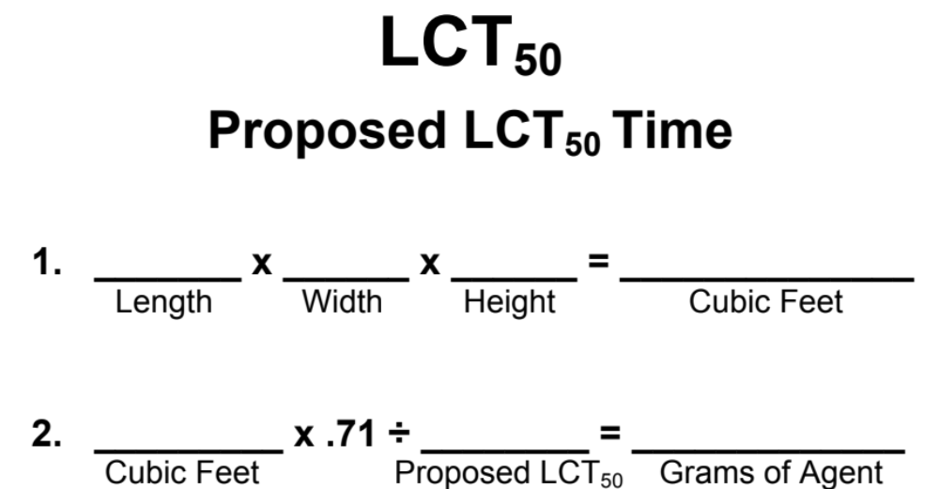

Slide 12
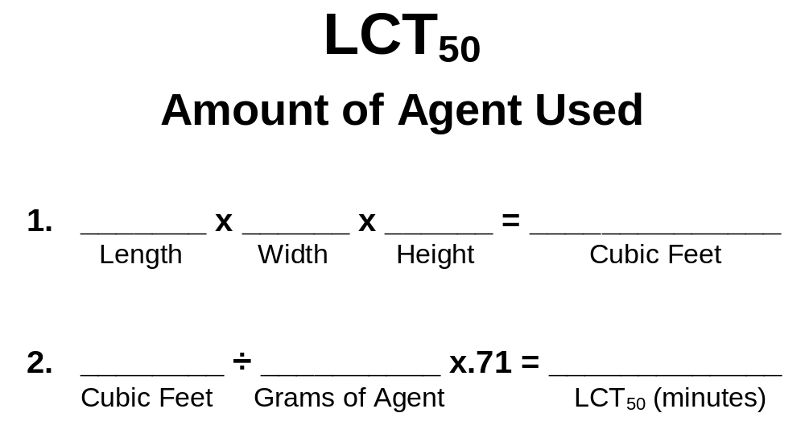

Slide 13
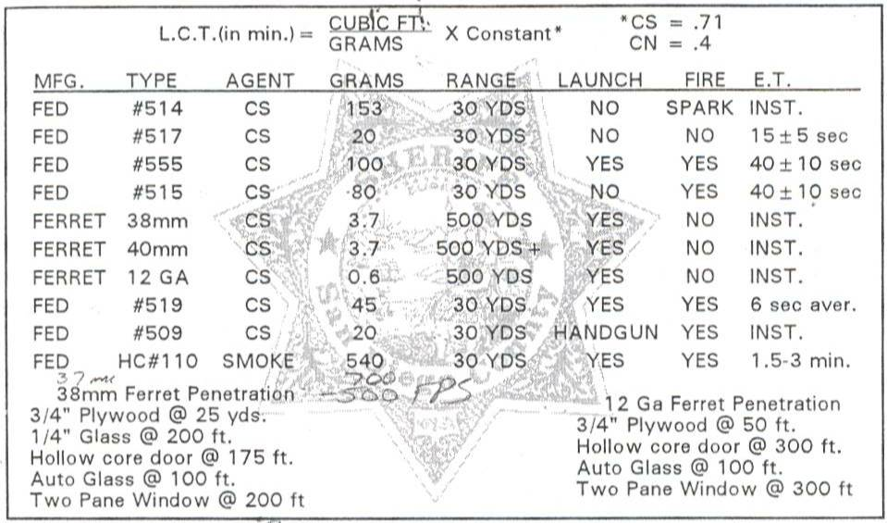
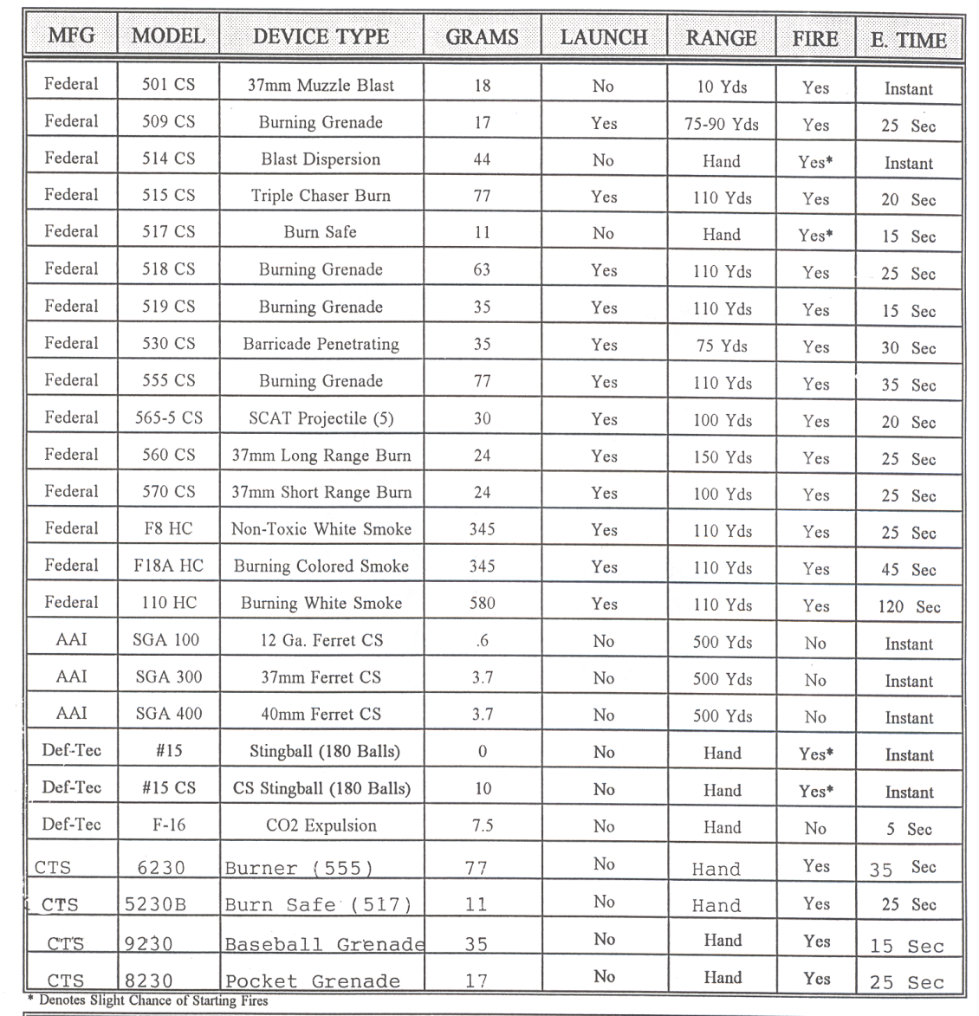
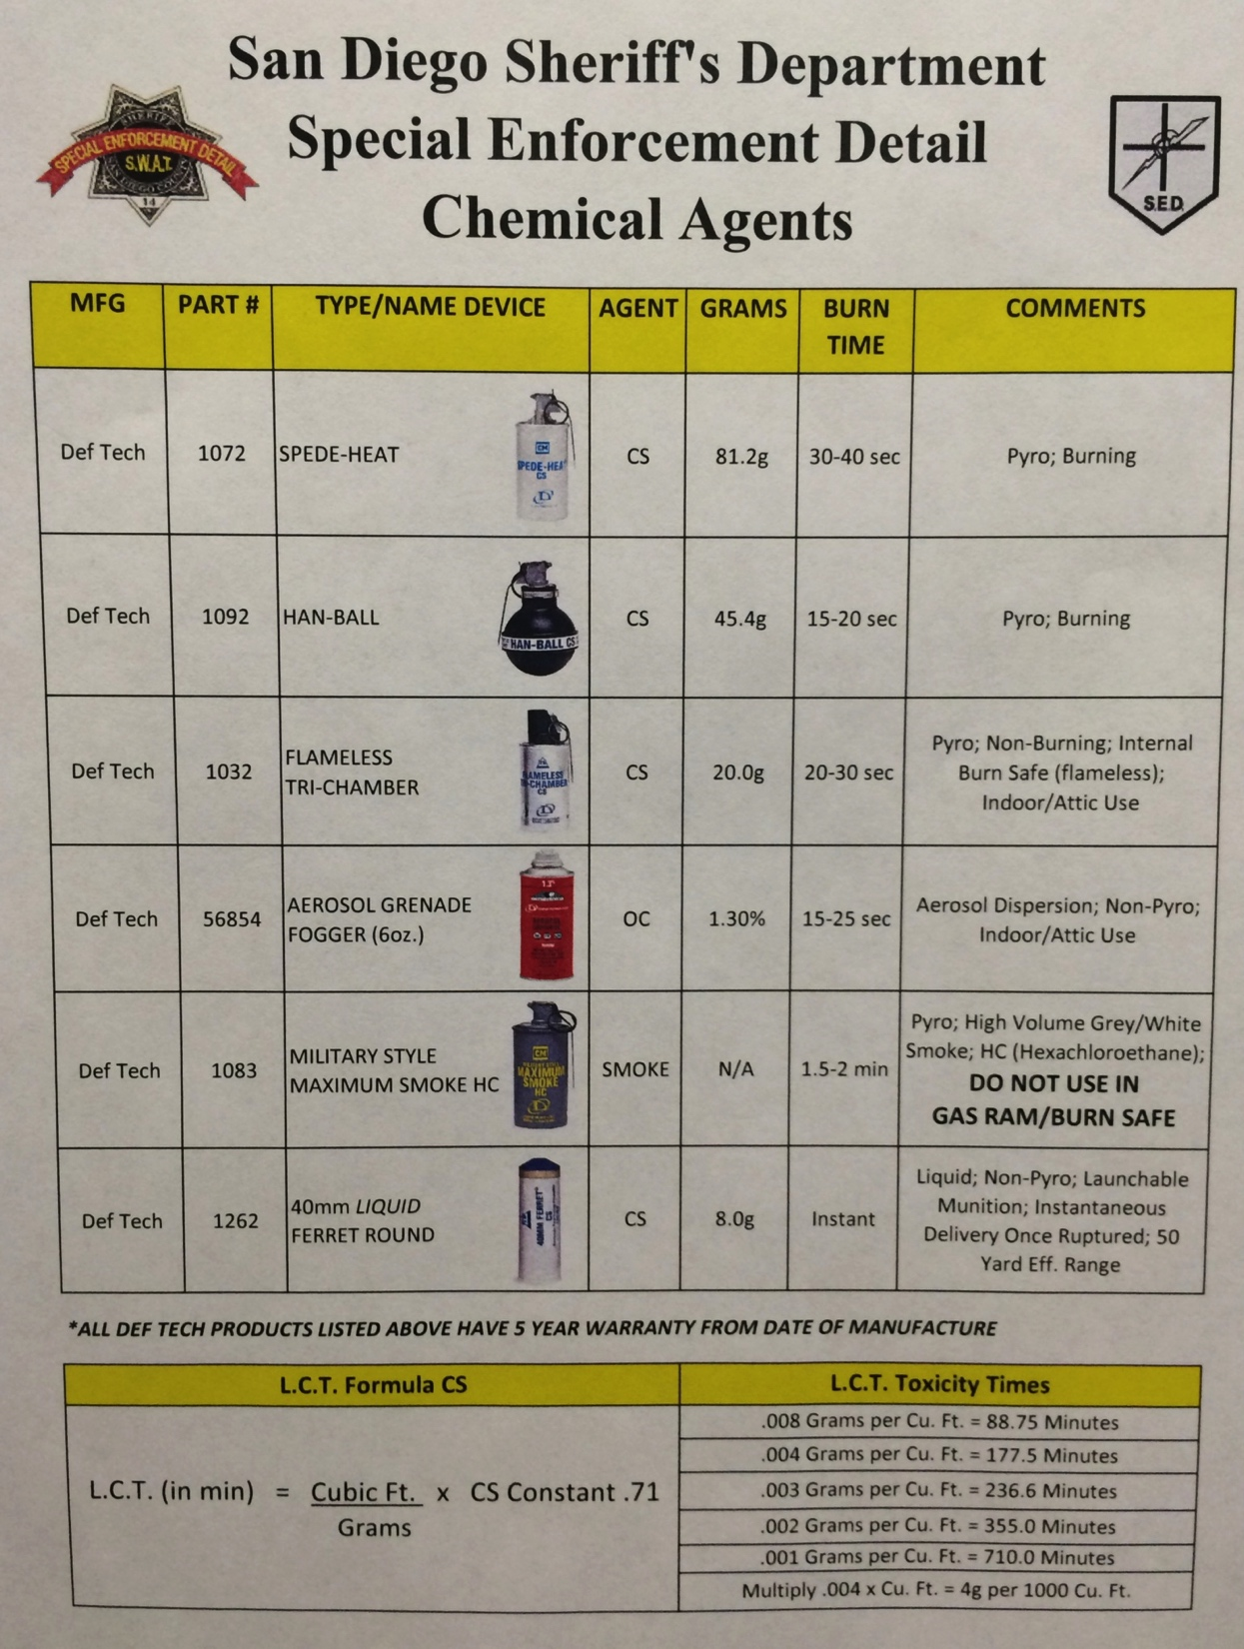
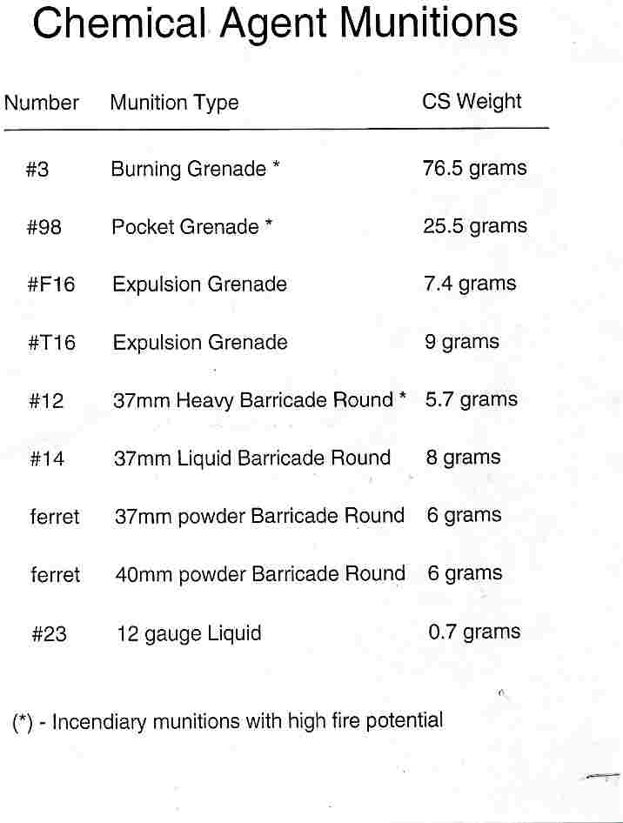
Munitions Data Card
Now that we know the “total # of grams of agent” and our LCT₅₀, how many munitions will we need?

Slide 14
Questions or
Comments

